Slide 1

Remote Excavator Team
Alec Boyce, Ryan Fortier, Davis Geniza, Oscar Nunez, Zhiyu Wang

Slide 2
Project Description
The purpose of project is to make a remote-control excavator
Engineering requirements description:
  a fully electric, remotely operated, small scale excavator
Objective Change(due to the Covid-19)
  The arm with hydraulic system

Slide 3
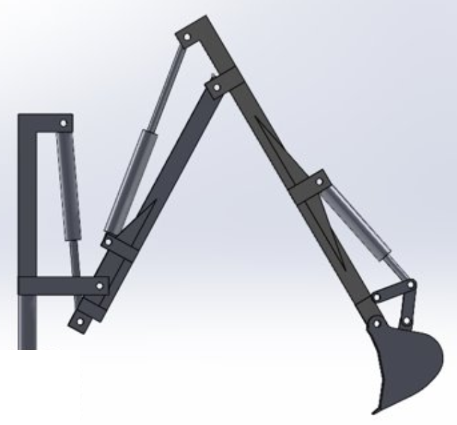

Design
The design that was chosen to construct eliminated the need for a 4 RAM system.
This design also lowered manufacturing costs and arm weight.

Slide 4
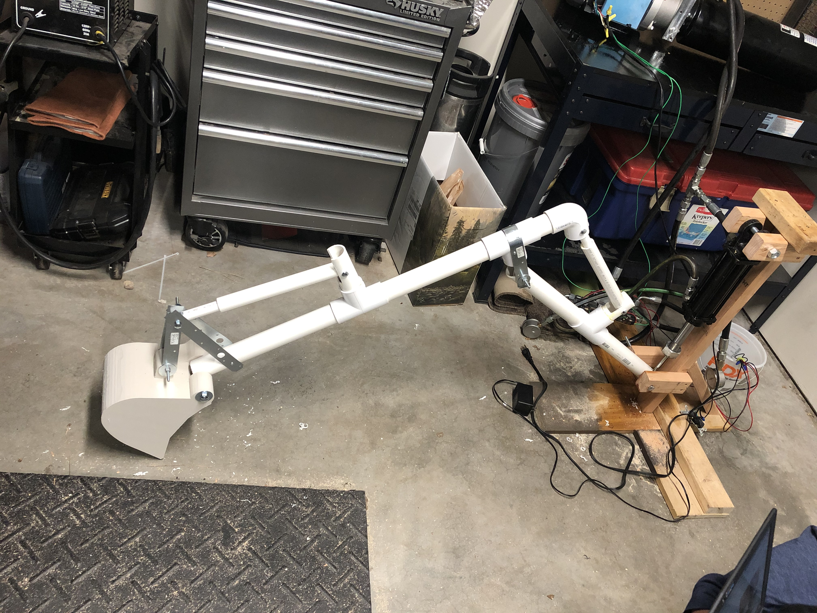
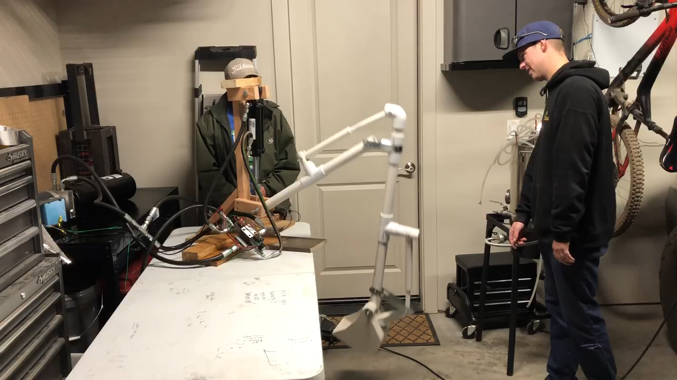
Design Continued
The manufactured design features one operational RAM and two demonstrational RAMS.
The design dimensions from Solidworks were used to construct the prototype.
The video shows a kinematic demonstration of the prototype.

Slide 5
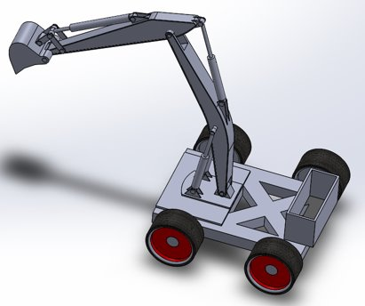
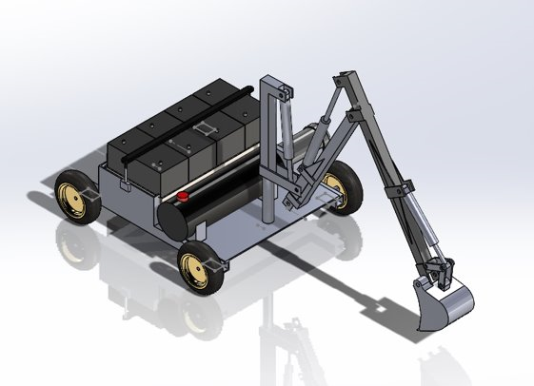
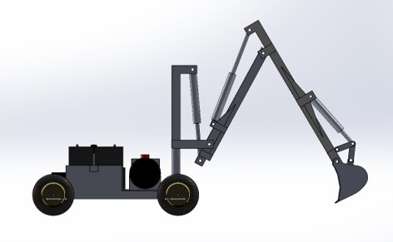
Decision Making
Original design utilized its wheels to turn the excavator's arm.
Final design assembly utilized a tower capable of rotating the arm without moving the excavator's body.
Final design provides easier operability for the user.
Design saves potential cost by reducing number of rams, smaller manifold.

Slide 6
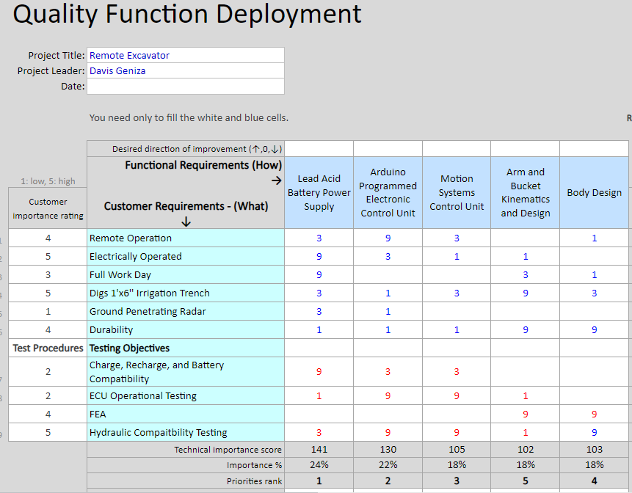
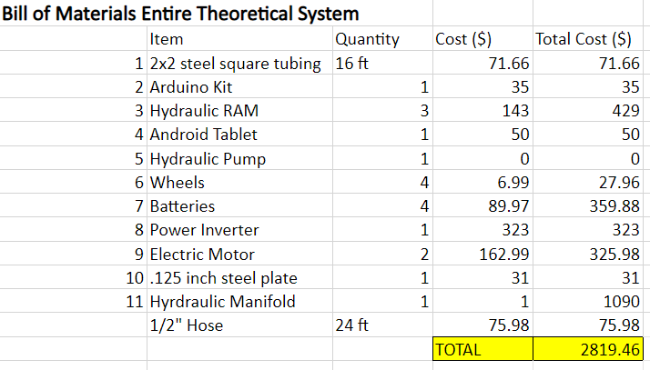
Decision Making
Early design choices stemmed from a QFD.
Powering the excavator with lead acid batteries, providing a full work-day before charging.
Remote operating with Arduino Bluetooth and an Android tablet.
Composing of mostly steel.
Original budget to create entire system ~ $2,800.

Slide 7
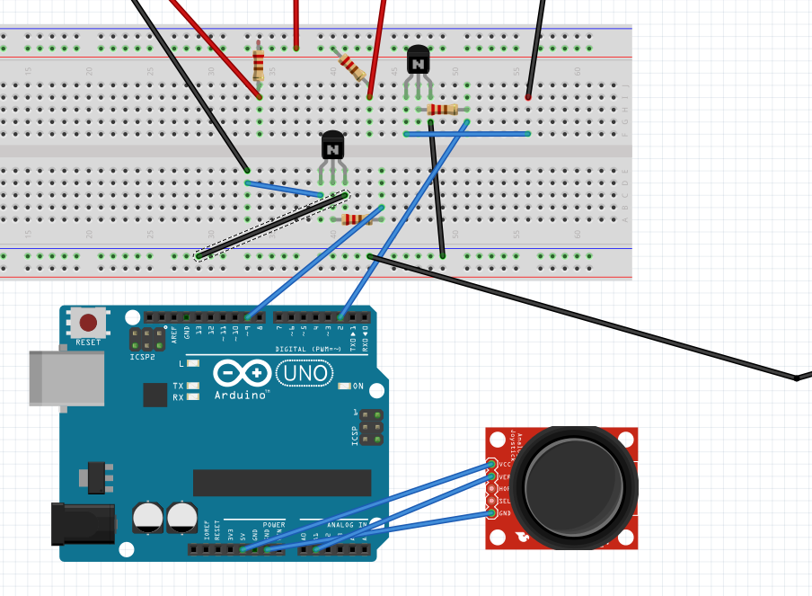
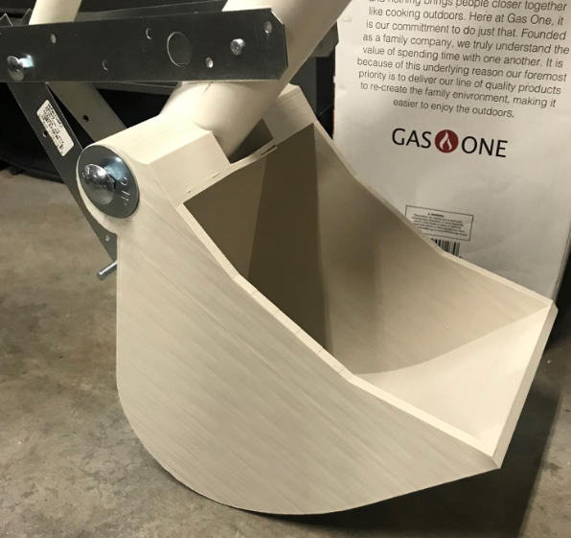
Decision Making
COVID complications delayed purchasing and limited complete construction.
Prototyping the arm design became the main objective, proving the design would be compatible with the hydraulic system available.
A 3-D print of the bucket was created for the prototype, allowing the bucket design to be created closer to specification. Original design designated a steel bucket.
An Arduino joystick module is used to control the ram connected to the prototype.

Slide 8
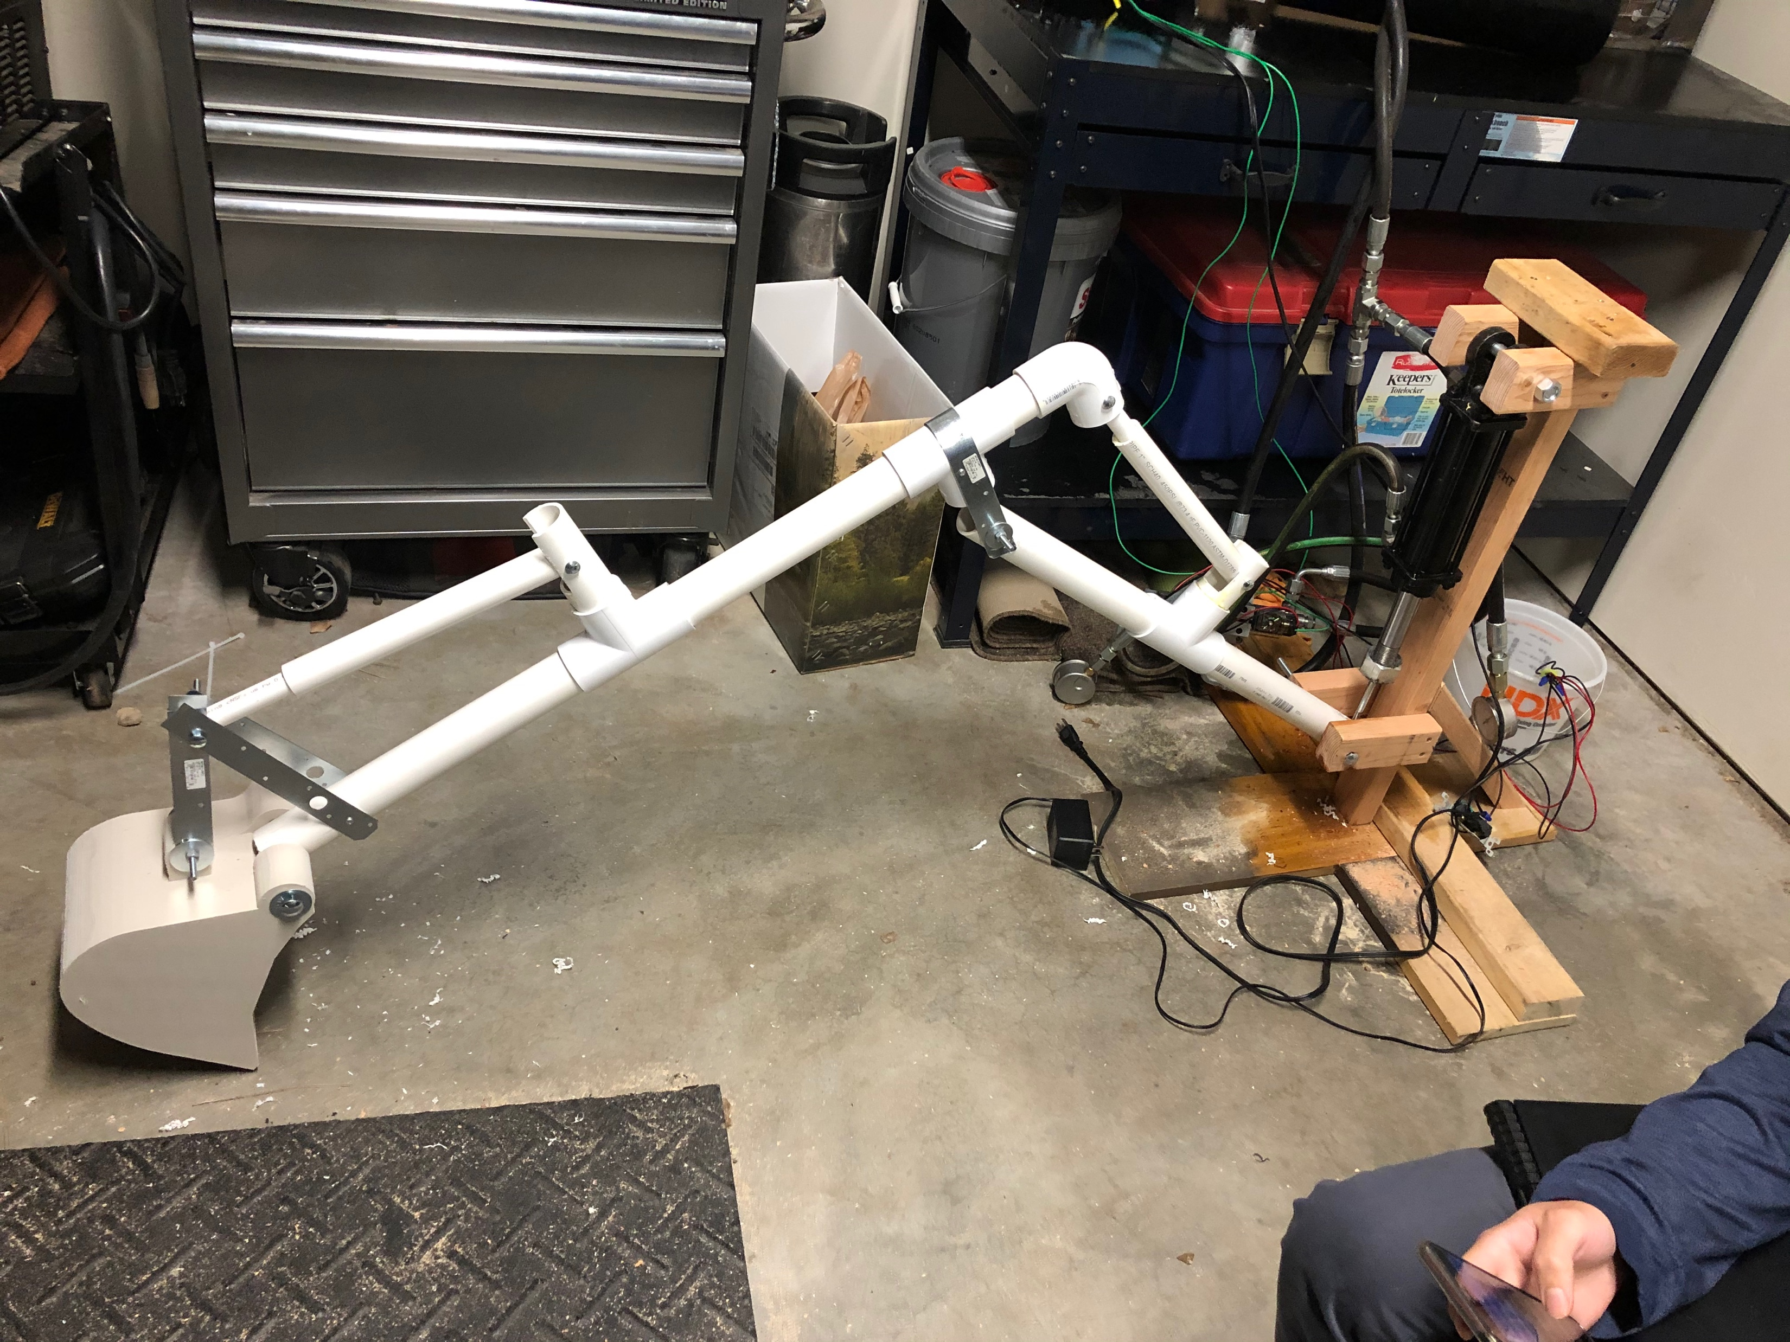
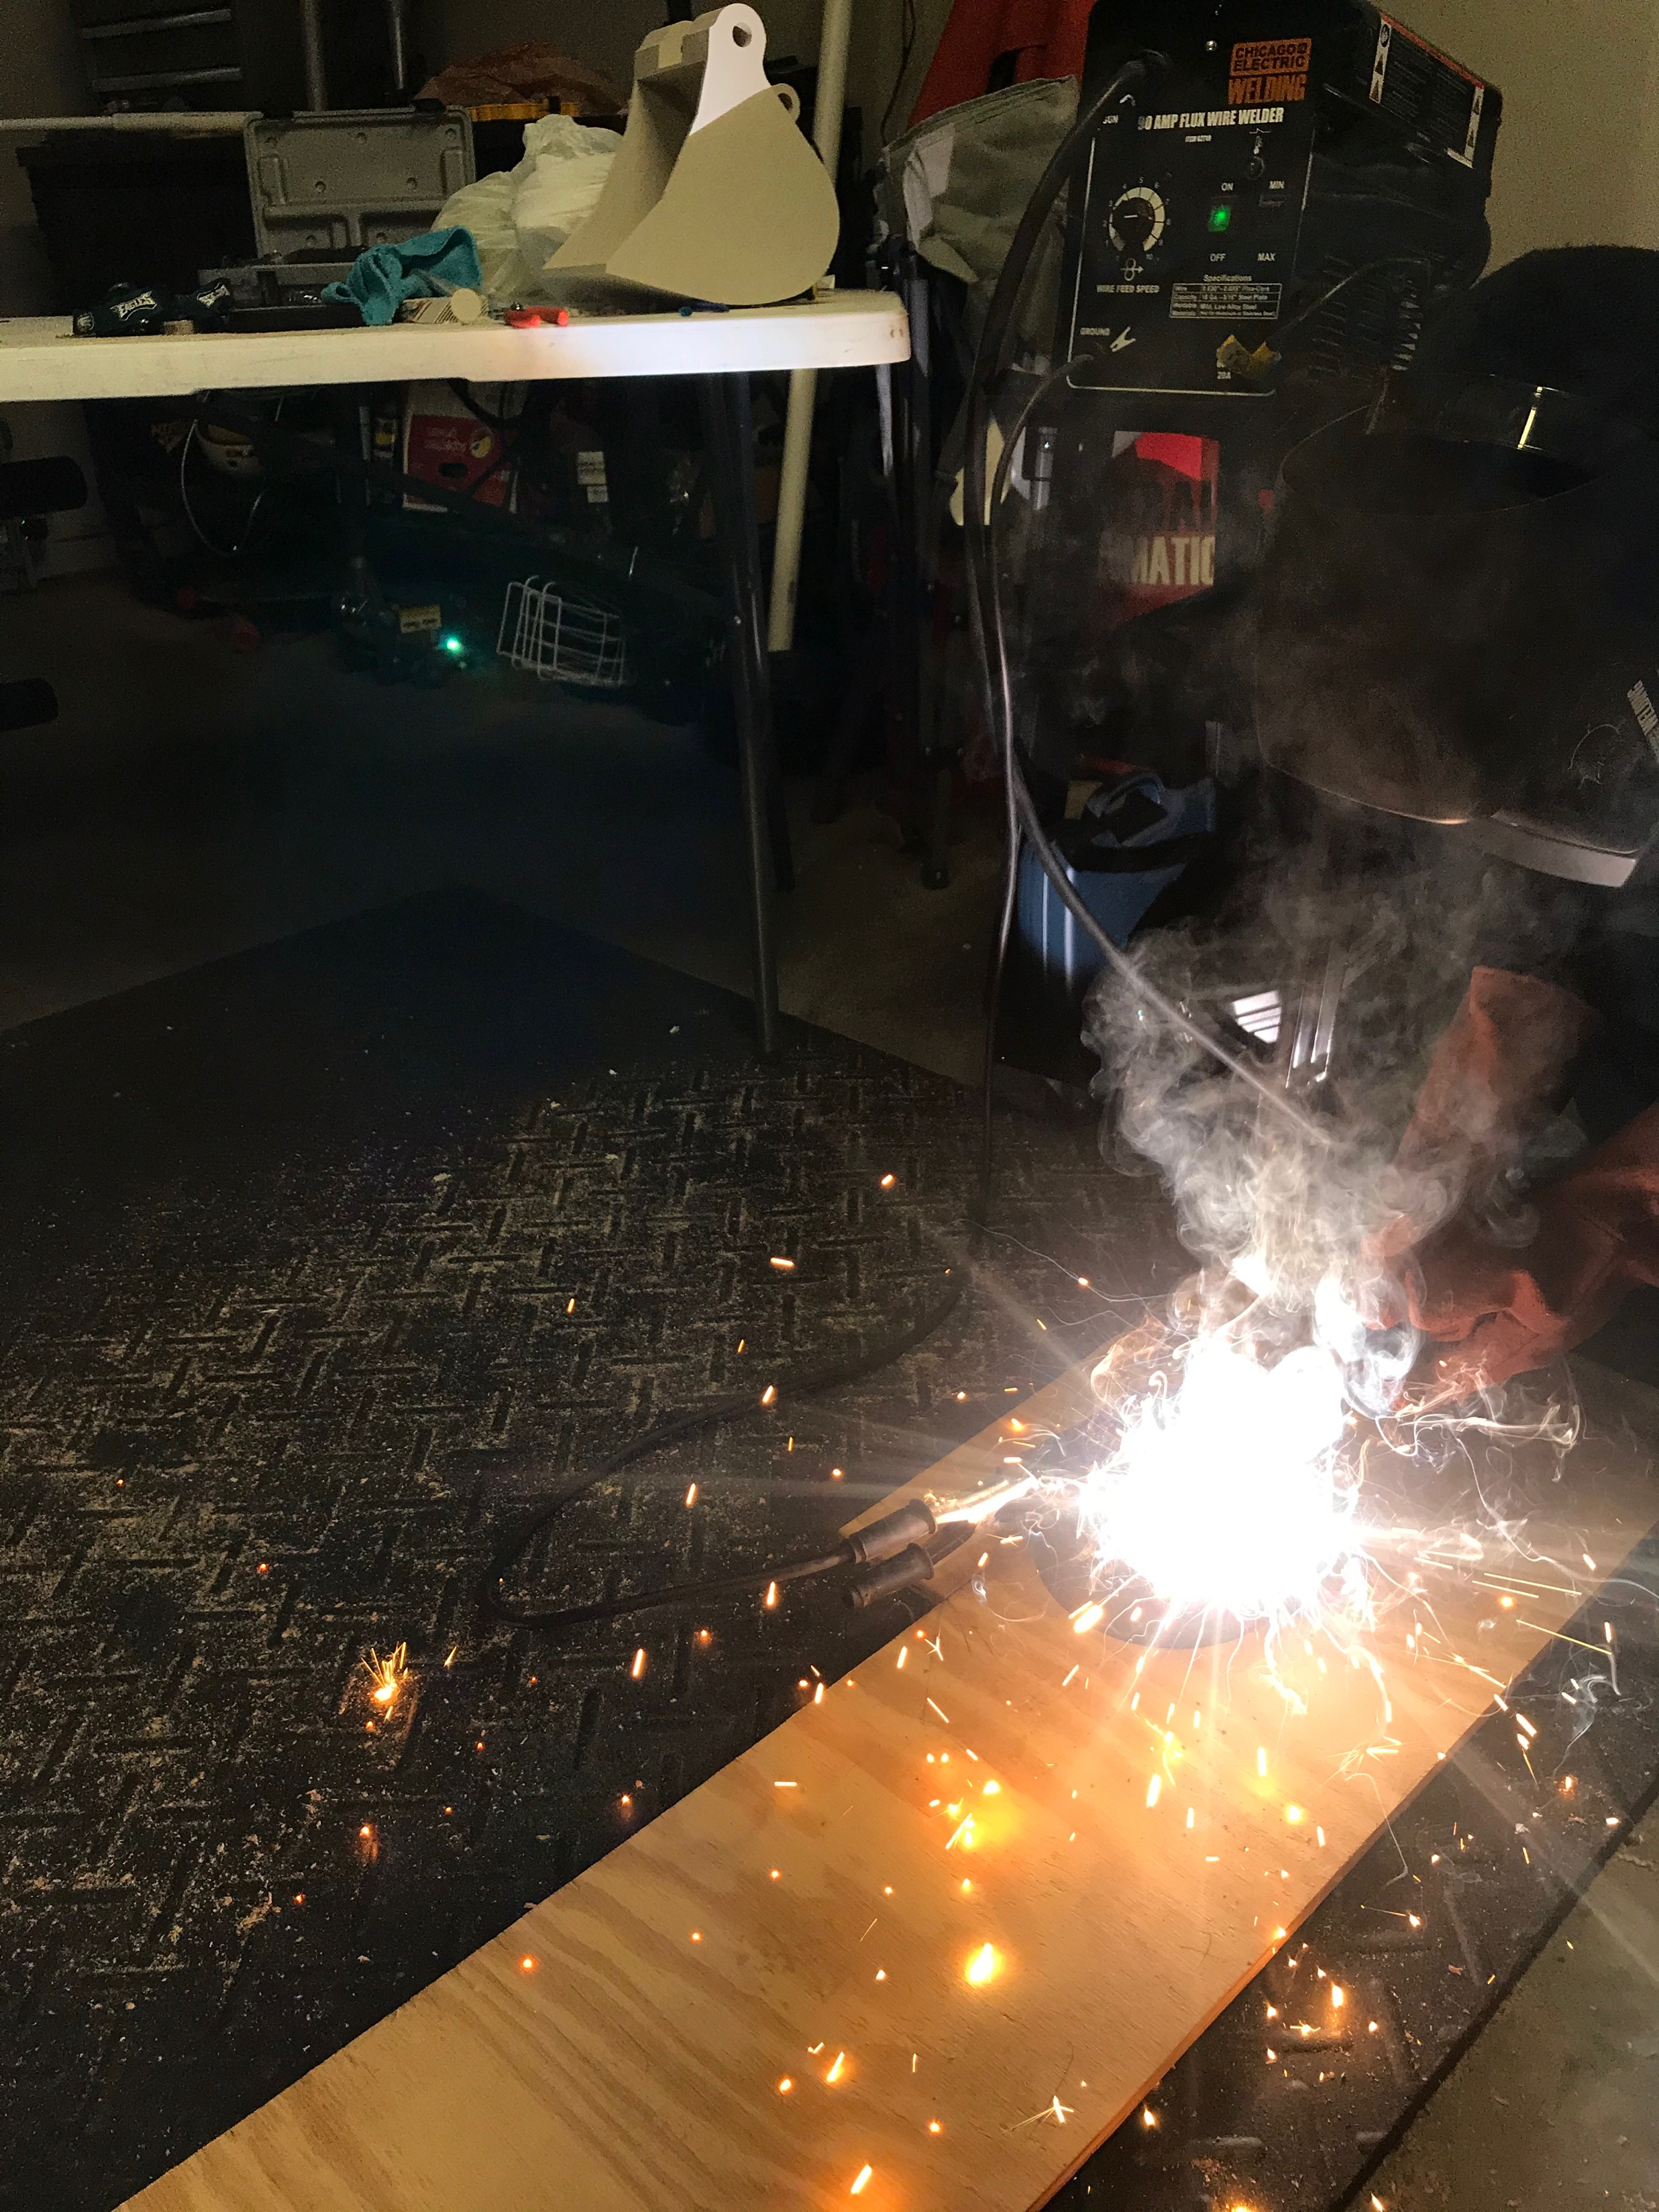
Manufacturing
Manufacturing took place in Alec’s garage
Total time to manufacture the concept 37 hours
PVC, wood 3D printed bucket with hardware to piece it all together
Started with base and moved to boom and dipper
Customer requirements include electric powered concept, durability, ability to dig a 1’ by 6” trench and wireless control (working out kinks).
Welding, cutting, drilling, CAD modeling for design and printing of the bucket, as well as electronic controlling

Slide 9
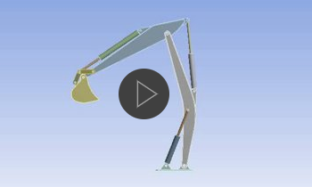
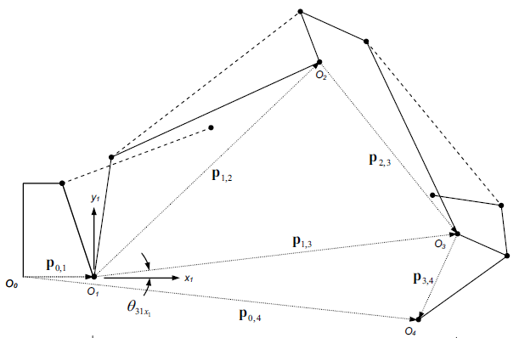
Testing
Developed Testing System
Multi-Level Testing and Validation
Compare Theoretical outputs against Real outputs
Theoretical outputs consist of Kinematic analysis and FEA
Use FEA to optimize design
Real outputs produced by excavator determined by hydraulic components and quality of build

Slide 10
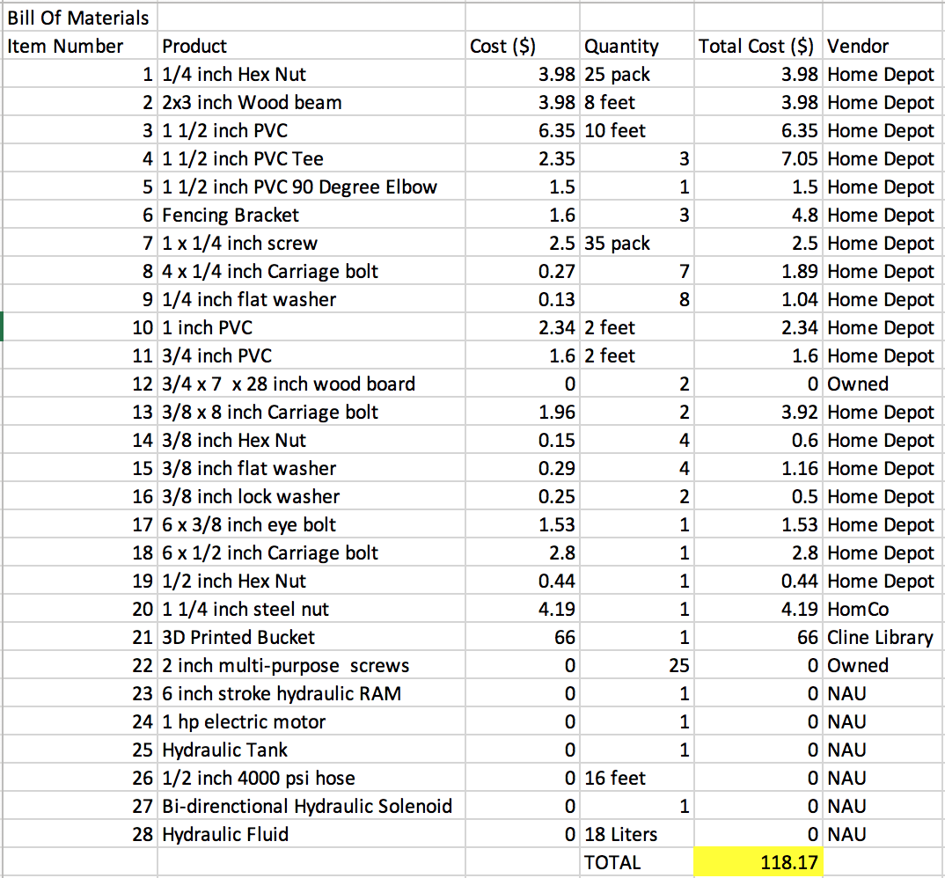
Budget

Slide 11
Future Work
Quality Discussion and Clear Plan
  Connecting to electrical system
  Final test
implementation and manufacturing
  arm part, hydraulic system and electrical system
  base part, wheels and other parts

